Slide 1


Abusing WCF Endpoints for RCE and Privilege Escalation

Slide 2
root@ill:~# whoami
Chris Anastasio
Penetration tester at illumant
Interested in vulnerability research and exploit development
CCNA, Linux+, OSCP, OSCE
Hacking is my job && my hobby!
Notes:
Don’t want to make things more secure. Just want to hack.

Slide 3
Agenda
Brief intro to WCF
WCF target enumeration
Example vulnerable service
Real world vulnerability analysis and exploitation
DEMO
Notes:
The purpose of today’s presentation is review what WCF is. As well as examine bugs and the exploitation workflow.

Slide 4
Motivation
Fabius Watson (@FabiusArtrel) presented his research around WCF exploitation at EkoParty 2018
His work inspired us to find similar bugs
We believe this attack vector is underhyped
This stuff is fun!!!
Notes:
A friend of mine found a number of logic bugs related to insecure WCF implementations. After reviewing his work we found some similar issues. We believe the attack vector is underhyped and want to get the word out.

Slide 5
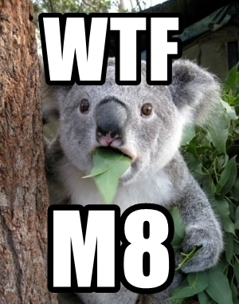
WTF is WCF?

Slide 6
WTF is WCF?
WCF – Short for Windows Communication Foundation
Platform which simplifies development of service oriented applications
WCF services perform actions on behalf of clients
Communications can take place over a variety of protocols including TCP, HTTP, and named-pipes
Notes:
Service oriented: client/service. Service performs actions on behalf of the client.
TCP HTTP and named-pipes are the only bindings we have encountered in real world software

Slide 7
WTF is WCF?
WCFService endpoints are defined with by an:
Address
Binding
Contract

Slide 8
WTF is WCF?
The Address is a URI which uniquely identifies the endpoint
It’s broken into 3 or 4 parts
Example:
net.tcp://
81
localhost:
/vulnservice/runme
Scheme
Host
Port
Path

Slide 9
WTF is WCF?
Bindings specify how to communicate with the endpoint and include:
The transport protocol (TCP/HTTP)
The encoding scheme (text/binary)
Transport security (TLS)
System provided bindings include:
BasicHttpBinding, NetTcpBinding, NetNamedPipeBinding
Many others
Notes:
Important for binding configurations of client to match the service
These are the only bindings we have seen in the wild

Slide 10
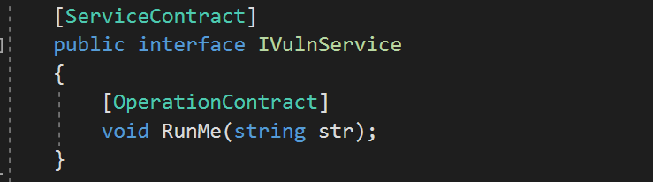
WTF is WCF?
Contracts define what functionality the service exposes
The ServiceContract attribute is applied to classes or interfaces to expose them as a WCF service
The OperationContract attribute is applied to methods to expose them as part of the functionality provided by the service
Notes:
Service Contract is applied to interfaces or classes
Operation Contract is applied to methods

Slide 11

Target Enumeration
.NET binaries
WCF was released in 2006 with .NET Framework 3.0
Local targets
Focus on services running as privileged users like LocalSystem or LocalService
Remote targets
Needs to use a network binding like NetTcpBinding
Notes:
LocalSystem can still priv esc via rotten potato

Slide 12
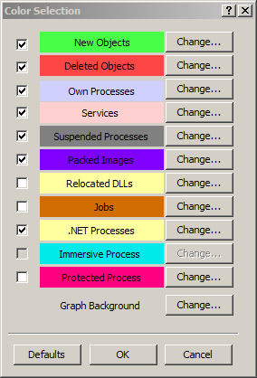
Target Enumeration
Process Explorer makes it possible to identify local target services quickly
It can be configured to highlight .NET processes

Slide 13
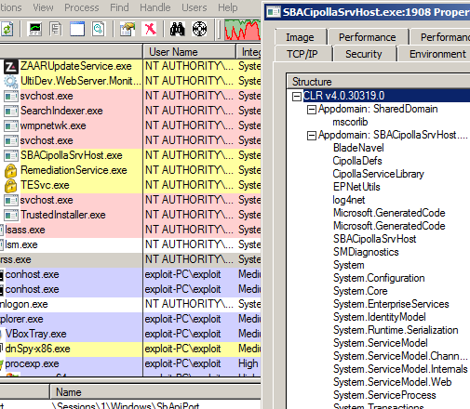
Target Enumeration
By clicking on properties for a specific process the loaded .NET assemblies can be inspected
It’s possible to check for references to System.ServiceModel which is the assembly that provides the classes needed to create WCF services.

Slide 14
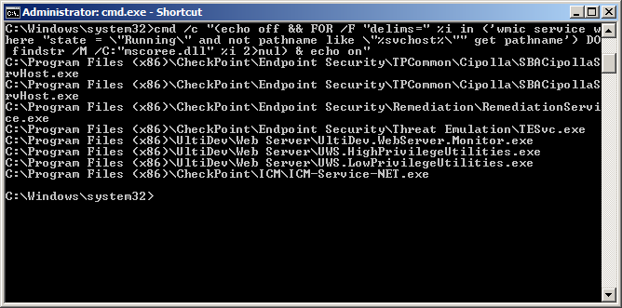
Target Enumeration
The WMI Commandline (wmic) tool can also be used
First a query to return all running services is issued
Next, each binary is searched for the string “mscoree.dll” which is a key dependency for programs written using the .NET Framework
cmd /c "(echo off && FOR /F "delims=" %i in ('wmic service where "state = \"Running\" and not pathname like \"%svchost%\"" get pathname') DO findstr /M /C:"mscoree.dll" %i 2>nul) & echo on"

Slide 15
Target Enumeration
The one liner in the previous slide has the disadvantage of resulting in some false positives/negatives
It has the advantage of working using only native tools
This makes it possible to run against all systems in a network using wmiexec or similar

Slide 16
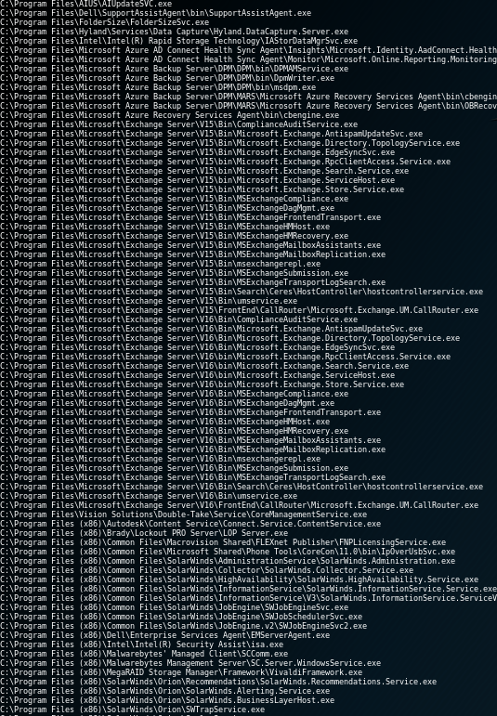
Target Enumeration
Running this against all windows systems in a modest LAN turned up quite a few results
The results can be trimmed by searching for strings like “ServiceModel” or “net.tcp” at the cost of decreasing accuracy

Slide 17
VulnWCFService
Forked version of VerSprite’s service made to be remotely exploitable.
Simple WCF service designed to help understand analysis and exploitation workflow
Available at https://github.com/illumant/VulnWCFService

Slide 18
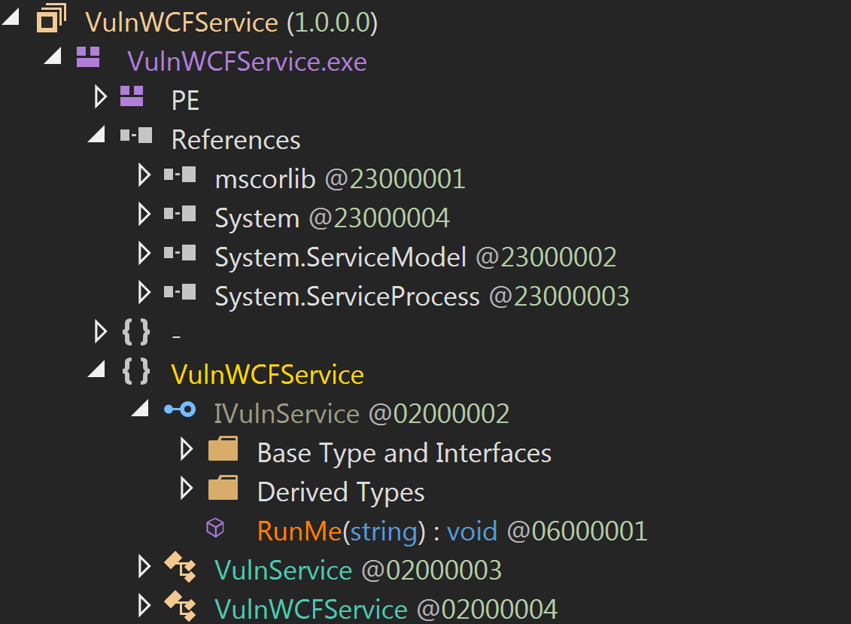
VulnWCFService - Analysis
Analysis of any WCF service will usually begin by decompiling the application
.NET programs decompile cleanly into source code
If needed de-obfuscators can help with obfuscated code
dnSpy is an open source tool that can be used for decompilation
Notes:
Dnspy is open source debugger, assembly editor, and decompiler

Slide 19
VulnWCFService - Analysis
We first want to examine the references, which are the application’s dependencies
System.ServiceModel is required to create WCF services
If this assembly is not referenced then WCF is not in use

Slide 20
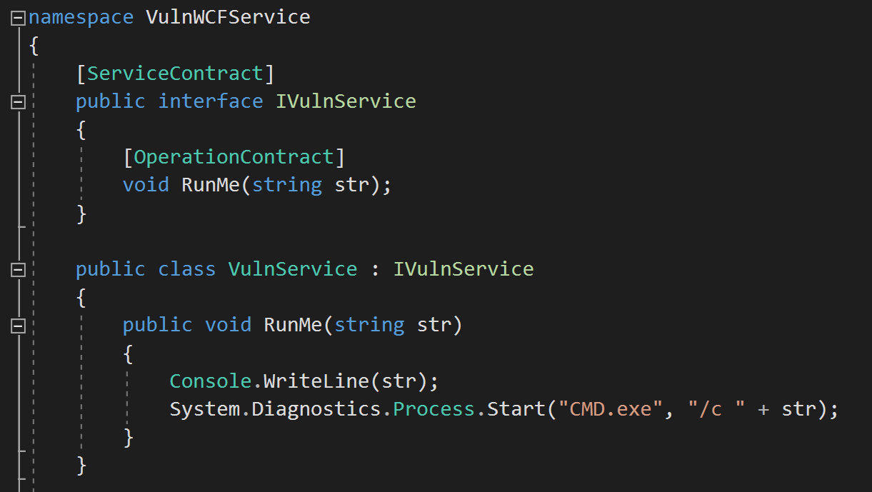
VulnWCFService - Analysis
Next is to inspect the contract for potentially exploitable methods
The ServiceContract attribute exposes the IVulnService interface as a WCF service
The OperationContract attribute makes the RunMe method accessible through the service

Slide 21
VulnWCFService - Analysis
The VulnService class implements the IVulnService interface
The RunMe method executes a client supplied operating system command

Slide 22
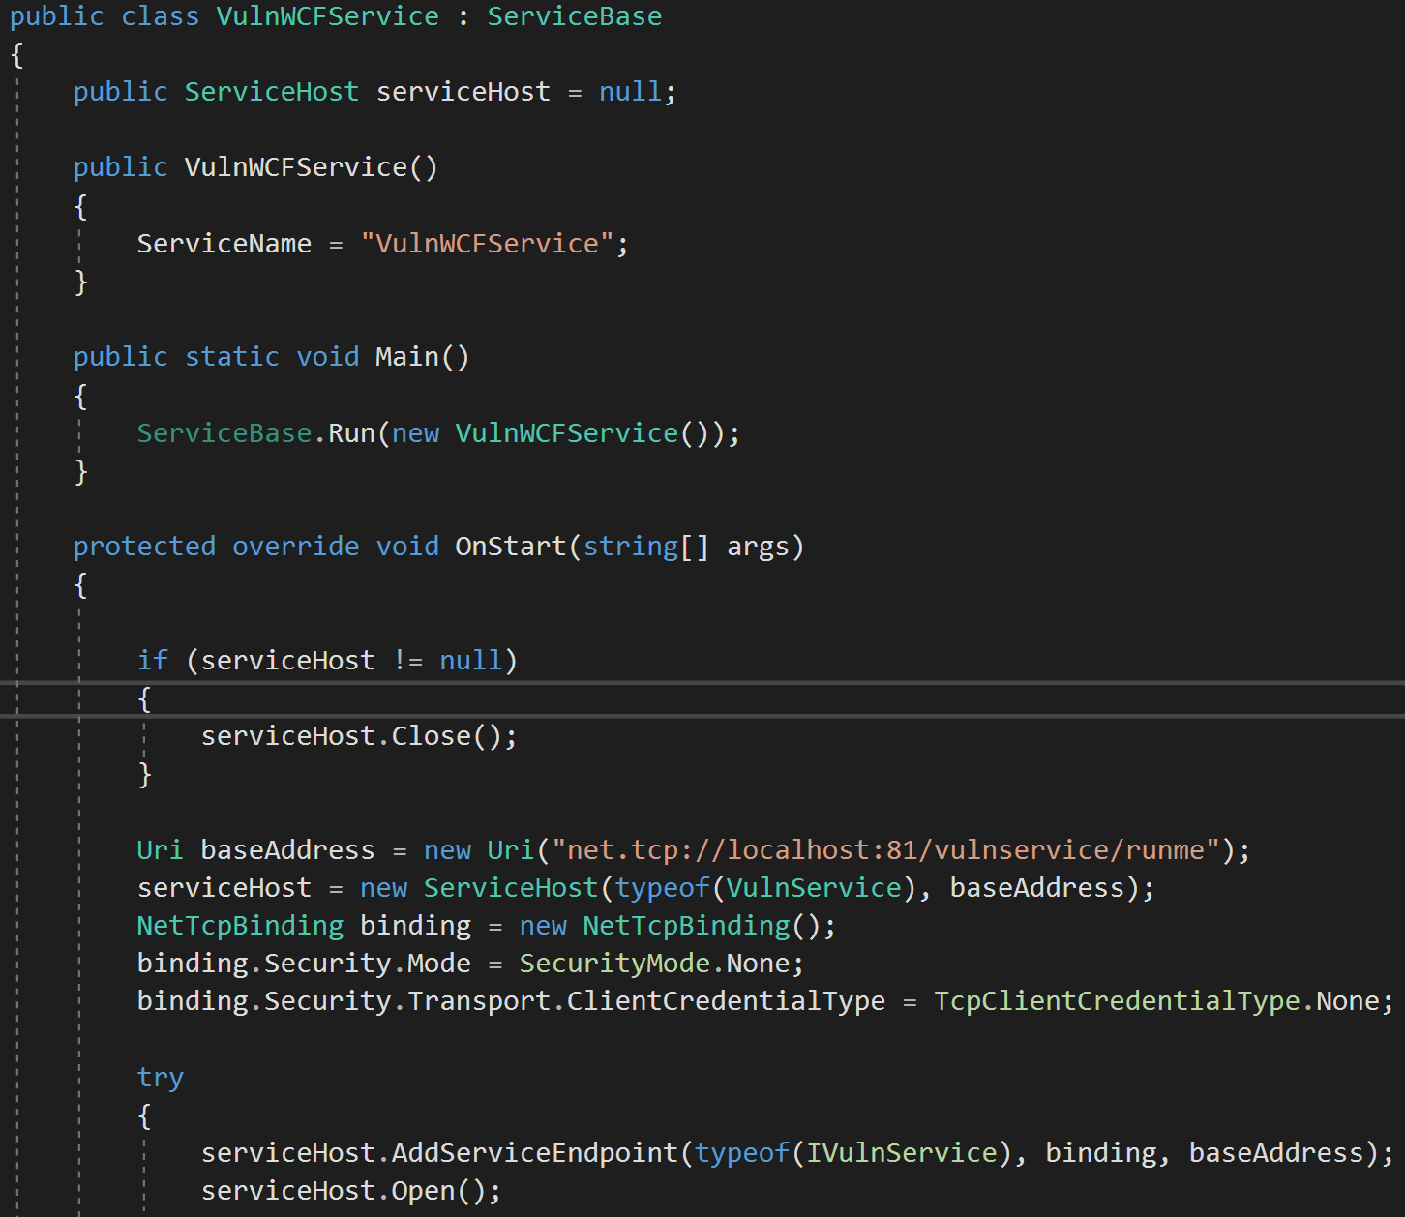
VulnWCFService - Analysis
VulnWCFService inherits from ServiceBase – used to build a Windows service
The OnStart method is called when a Windows service is started

Slide 23
VulnWCFService - Analysis
The Address is defined
Scheme: net.tcp
Host: localhost
Port: 81
Path: /vulnservice/runme
The Binding is defined:
NetTcpBinding is used
Service will be exposed over network
Binding security is disabled

Slide 24
VulnWCFService - Analysis
A call to AddServiceEndpoint is made which consumes the Address, Binding, and Contract to deploy the service
Calls to AddServiceEndpoint will help locate the information needed to connect to the service

Slide 25
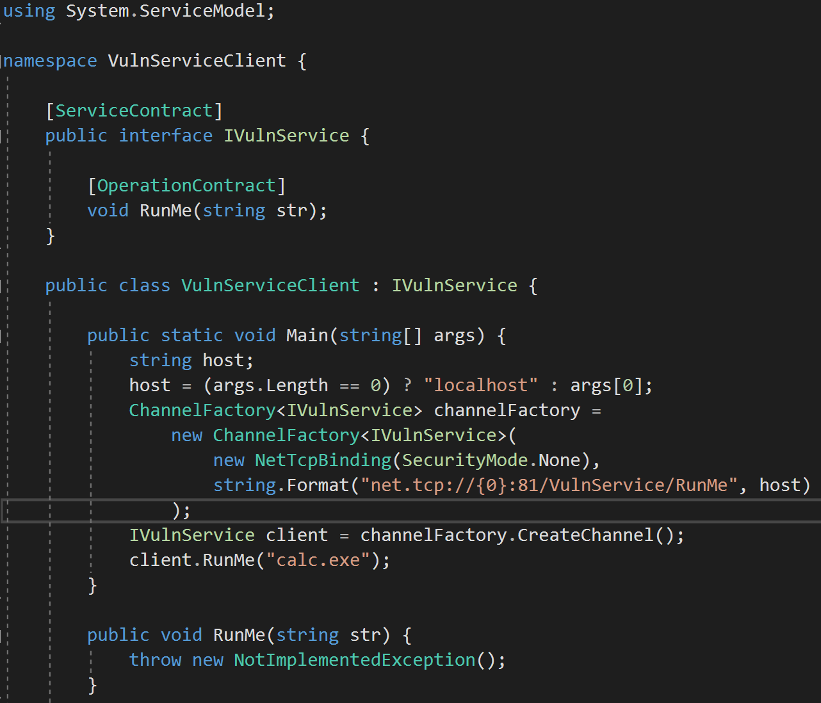
VulnWCFService - Exploitation
To exploit this service a WCF client must be developed
First add a reference to System.ServiceModel
Next define the service Contract
The interface method RunMe does not have to be implemented

Slide 26
VulnWCFService - Exploitation
WCF clients communicate over Channels
Channels are created using the ChannelFactory class which take an Address, Binding and Contract in its constructor
Calling CreateChannel on the ChannelFactory returns a client object which can be used to invoke the operations defined in the service contract

Slide 27

VulnWCFService - Exploitation
VIDEO

Slide 28
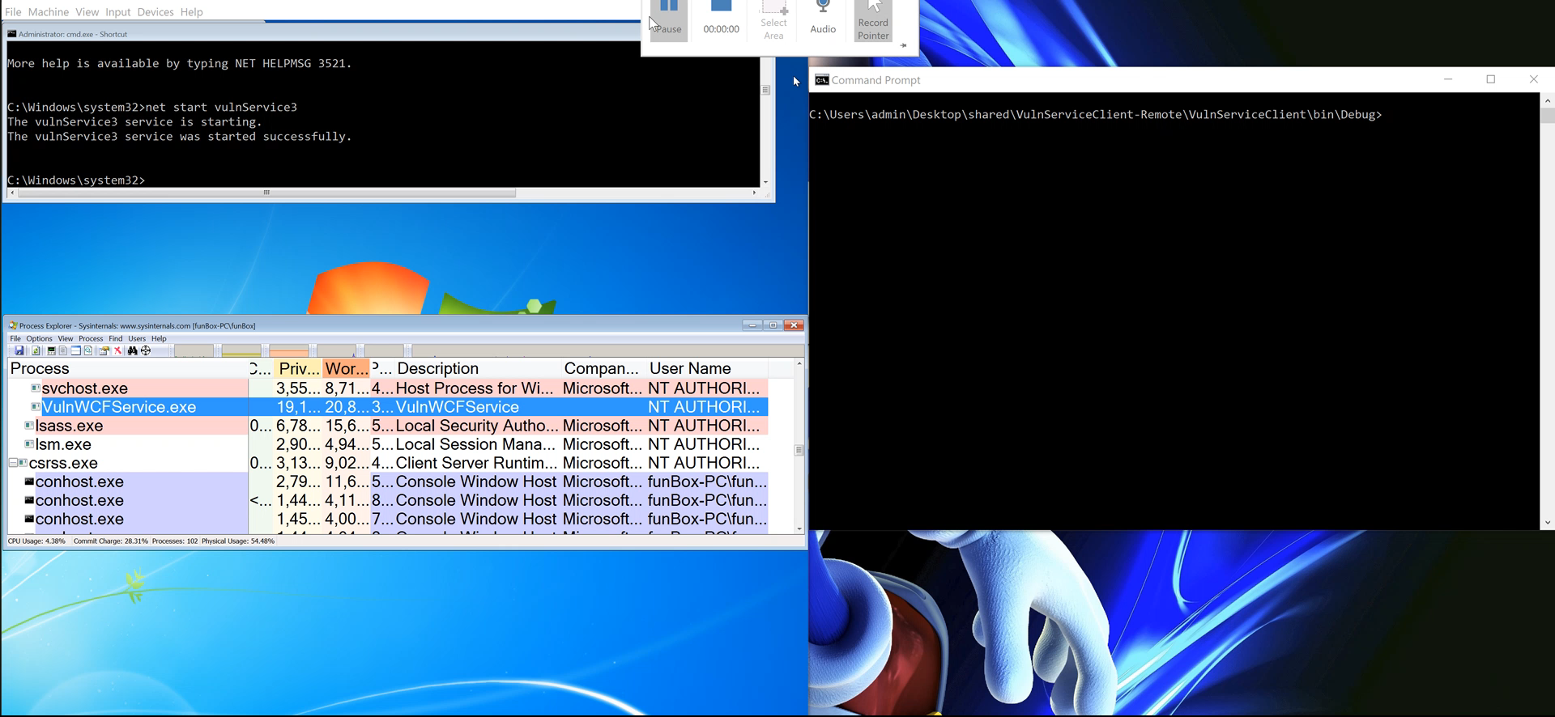
VulnWCFService - Exploitation

Slide 29
Real World Vulnerabilities
We’re looking for logic bugs
Software developers are not considering that rogue clients will attempt to interact with their services
Faulty attempts are made to prevent rogue access to the service

Slide 30
Check Point ZoneAlarm Priv Esc
Check Point’s consumer antivirus ZoneAlarm 8.8.1.110 suffers from a local privilege escalation vulnerability
The “Check Point Sandblast Agent Updater Service” establishes a NetNamedPipe WCF endpoint which can be accessed by unprivileged local users
Attackers can trigger a call to ExecuteInstaller and specify an arbitrary binary to be run as SYSTEM

Slide 31
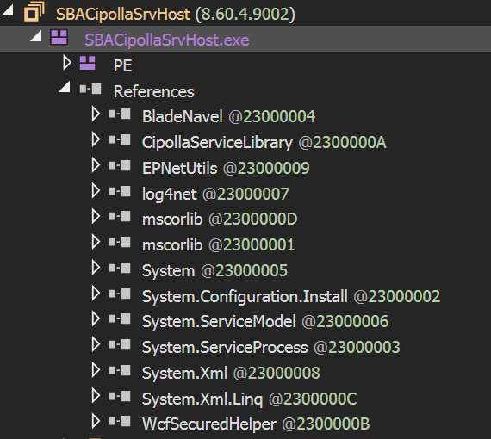
ZoneAlarm – Analysis
Googled for “best antivirus” and installed the software
Ran the wmic 1-liner and found quite a few .NET services had been started
Decompiled each service and checked for references to System.ServiceModel

Slide 32
ZoneAlarm – Analysis
Look for potentially exploitable functionality
Method names can be really helpful
SBAUpdater class has a method called ExecuteInstaller
This method executes an arbitrary EXE as SYSTEM based on a client supplied argument
Not too far off from VulnWCFService

Slide 33
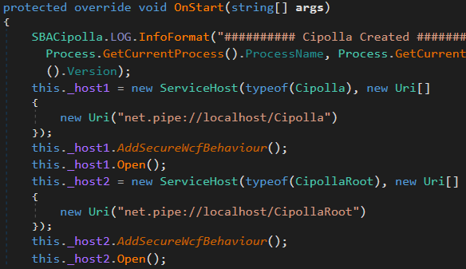
ZoneAlarm – Exploitation
Figure out how to connect to the service
Service endpoint definition is found in the OnStart method
Two named-pipe endpoints are established
Custom AddSecureWcfBehavior is invoked – a harbinger that some effort to secure the channel has been made

Slide 34
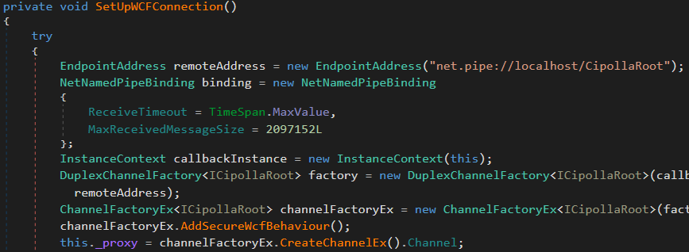
ZoneAlarm – Exploitation
Don’t build a client from scratch!
Existing client code can usually be found
SBAStub.dll has everything needed

Slide 35
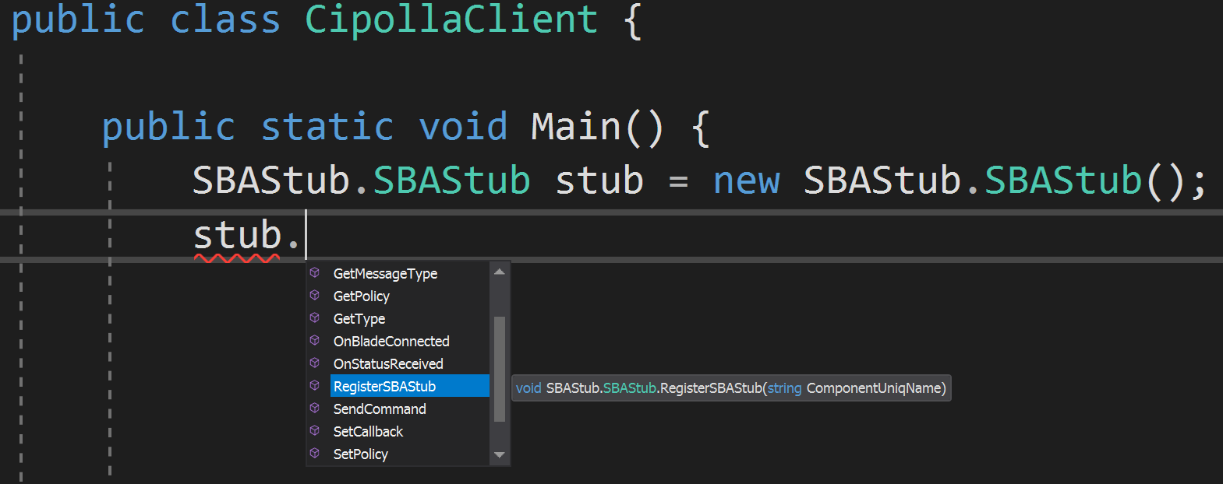
ZoneAlarm – Exploitation
A new C# project was created with references to SBAStub.dll and all its dependencies
We then created and SBAStub object and let Visual Studio tell us what methods could be called on it

Slide 36
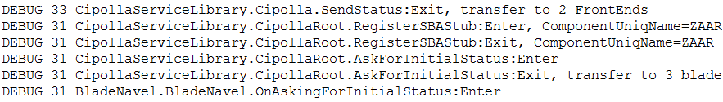
ZoneAlarm – Exploitation
The RegisterSBAStub method looked like a good first step at interacting with the service
Takes a single string as input
Successful stub registrations will be logged by the service

Slide 37
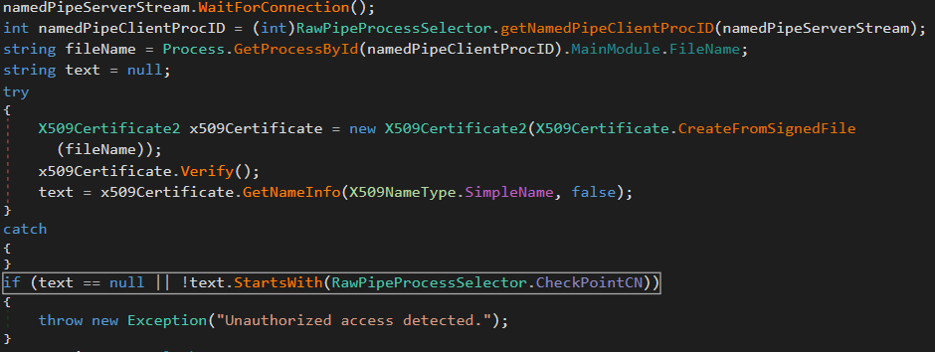
ZoneAlarm – Exploitation
None of our attempted registrations were getting logged!
After some tears reading the code the issue was found
The named-pipe server checks to see if client connections are coming from a Check Point-signed binary.

Slide 38
ZoneAlarm – Exploitation
Two options were considered to pass this check
Inject code into a legitimate signed binary
Sign the exploit with a self-signed certificate
James Forshaw pointed some other possibilities including:
The check employs Process.MainModule to get the filename of the connecting process.
This is read out of memory of the target process which is under attacker control

Slide 39
ZoneAlarm – Exploitation
An article by Matt Graber pointed out that on Windows “non-admin users are able to trust root CA certificates”
This means some PowerShell cmdlets can be used to sign the exploit code
$cert = New-SelfSignedCertificate -certstorelocation cert:\CurrentUser\my -dnsname checkpoint.com -Subject "CN=Check Point Software Technologies Ltd." -Type CodeSigningCert
Export-Certificate -Type CERT -FilePath c:\tmp\MSKernel32Root_Cloned.cer -Cert $cert
Import-Certificate -FilePath c:\tmp\MSKernel32Root_Cloned.cer -CertStoreLocation Cert:\CurrentUser\Root\
Set-AuthenticodeSignature -Certificate $cert -FilePath c:\tmp\exploit.exe

Slide 40
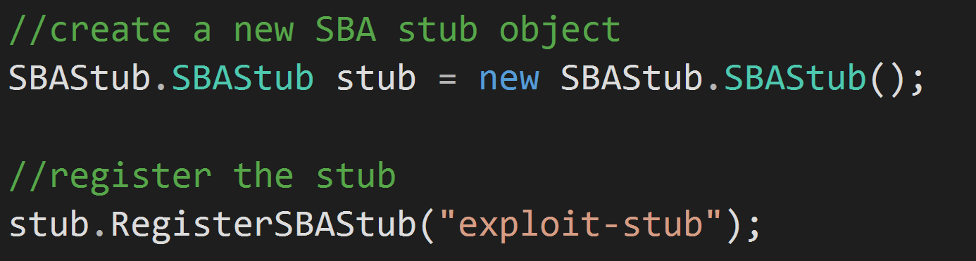

ZoneAlarm – Exploitation
With the code signed it’s possible to successfully register a stub

Slide 41
ZoneAlarm – Exploitation
With that working we started playing the with SendCommand method of the SBAStub object
Takes one argument, a string called CommandXML
Argument is received by the service’s OnCommandReceived method
CommandXML is eventually passed to ExecuteInstaller
The XML is deserialized into a few variables, including a string called InstallerPackagePath – used to spawn a new process

Slide 42
ZoneAlarm – Exploitation
The program pointed to by InstallerPackagePath must be signed by Check Point
Again two possibilities were considered to pass this check which are both viable
DLL hijack a legitimate signed binary
Sign the program with a self-signed certificate

Slide 43
ZoneAlarm – Demo

Slide 44
Conclusion
Exploiting the application logic exposed through WCF rather than WCF itself
Some developers are not conscious of the ability for untrusted processes to interact with the service
In other cases faulty attempts are made to prevent abuse
WCF as an attack surface does not seem to be well explored
Go Find bugs!

Slide 45
Questions
?

